Slide 1

Lecture 15 and 16
Fundamentals and Applications (CSO201A)
Dr. Srinivas Dharavath
Assistant Professor
Department of Chemistry
Indian Institute of Technology, Kanpur
Kanpur- 208016
E-mail: srinivasd@iitk.ac.in

Slide 2

Basic synthetic Methods

Slide 3
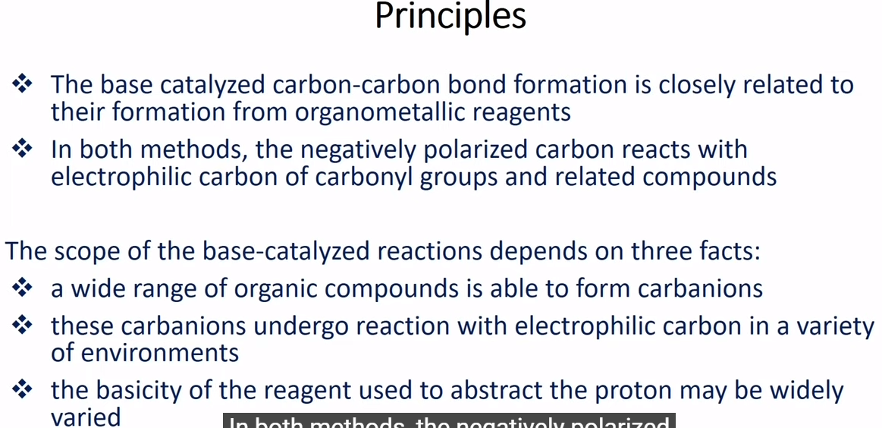
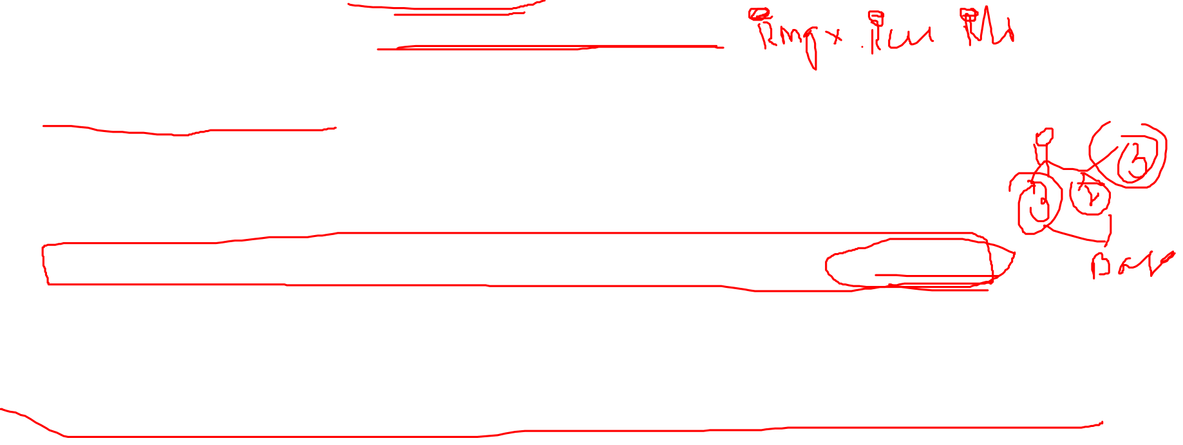
Base Catalysed Carbon-carbon Bond Formation reaction
Principles

Slide 4
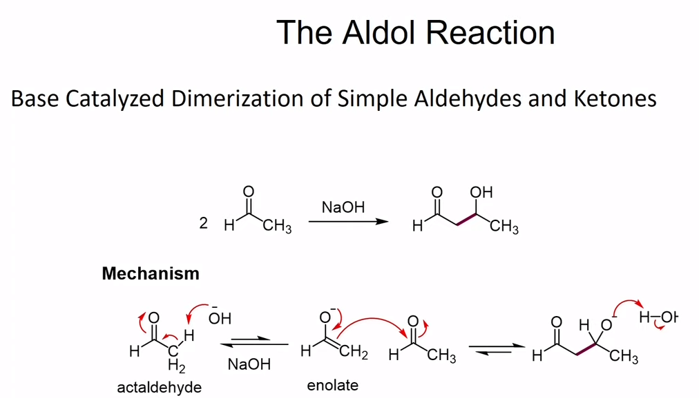
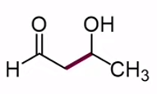
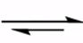
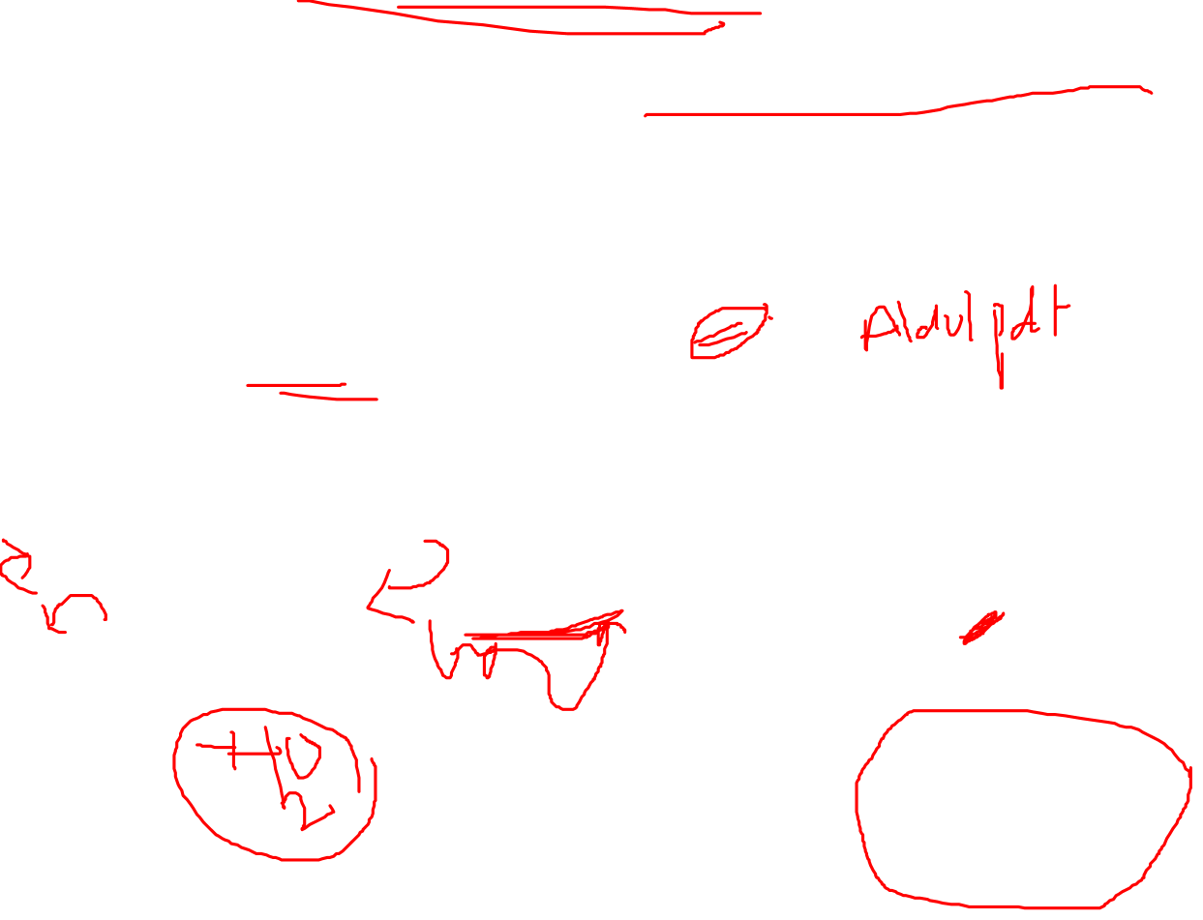
The Aldol Reaction

Slide 5
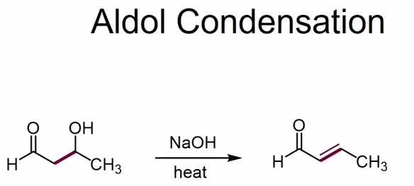
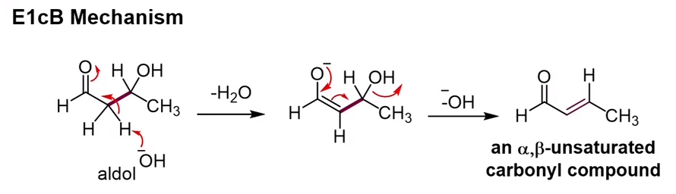
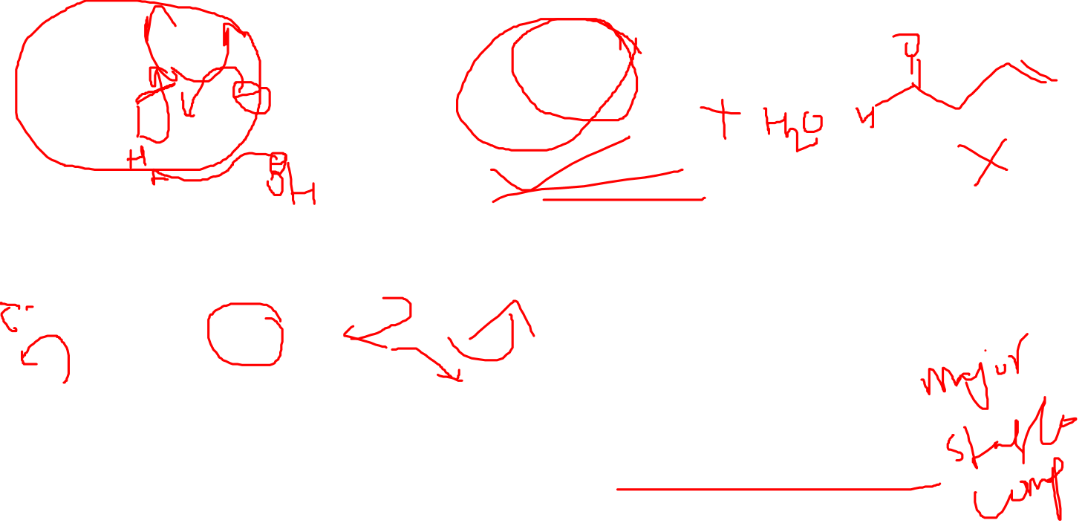
Aldol Condensation

Slide 6
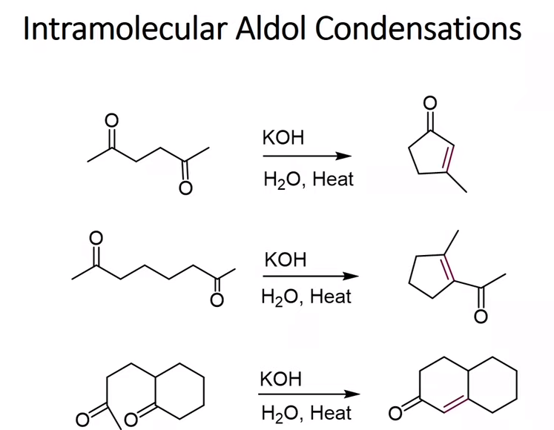
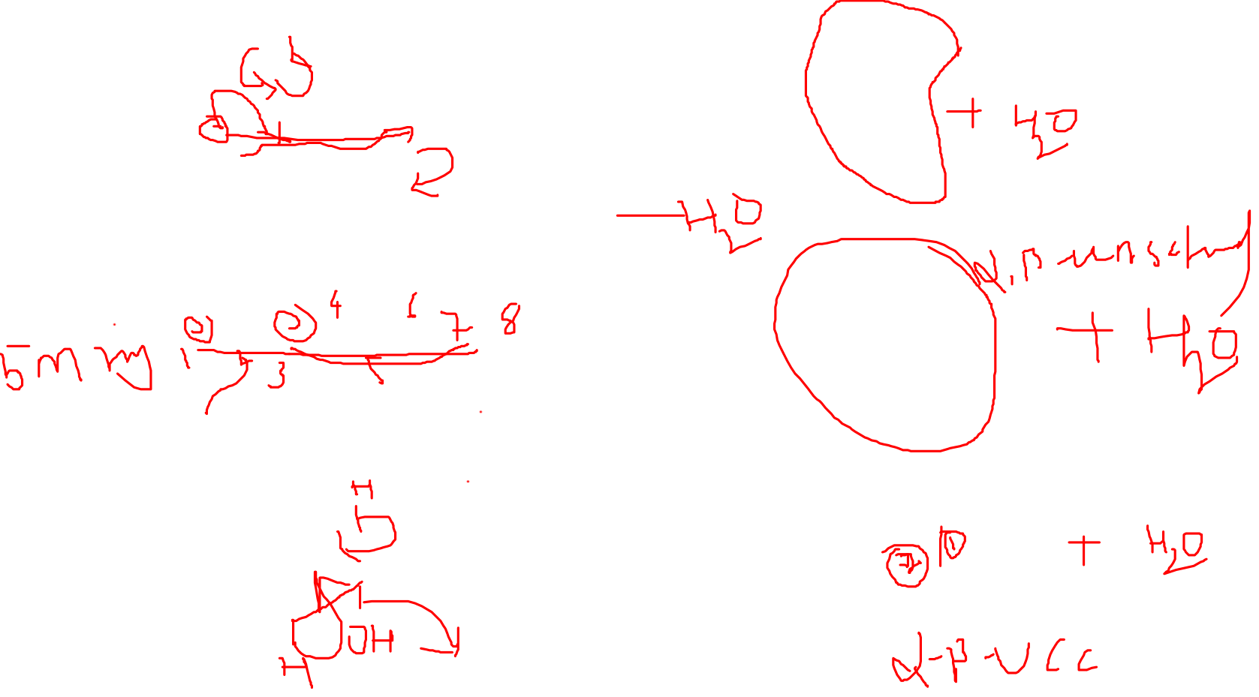
Intramolecular Aldol Condensation

Slide 7
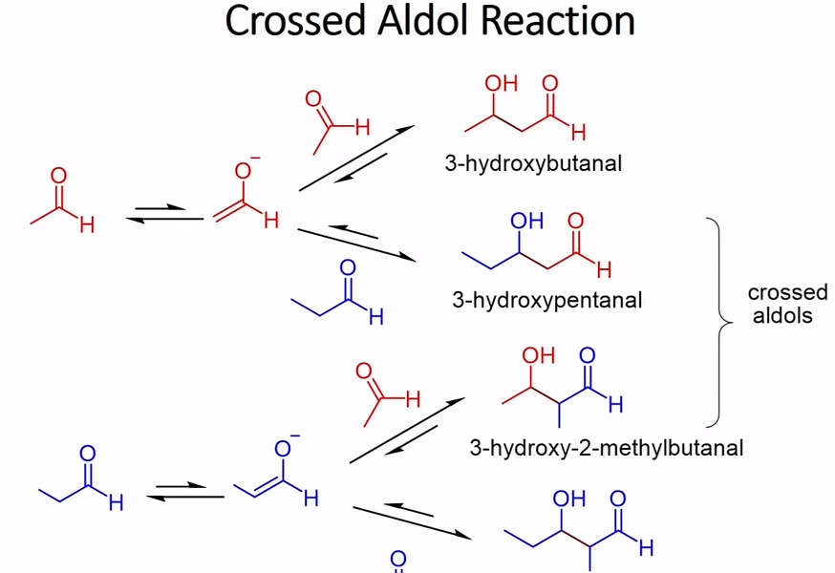
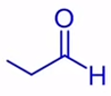
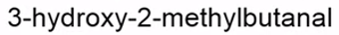
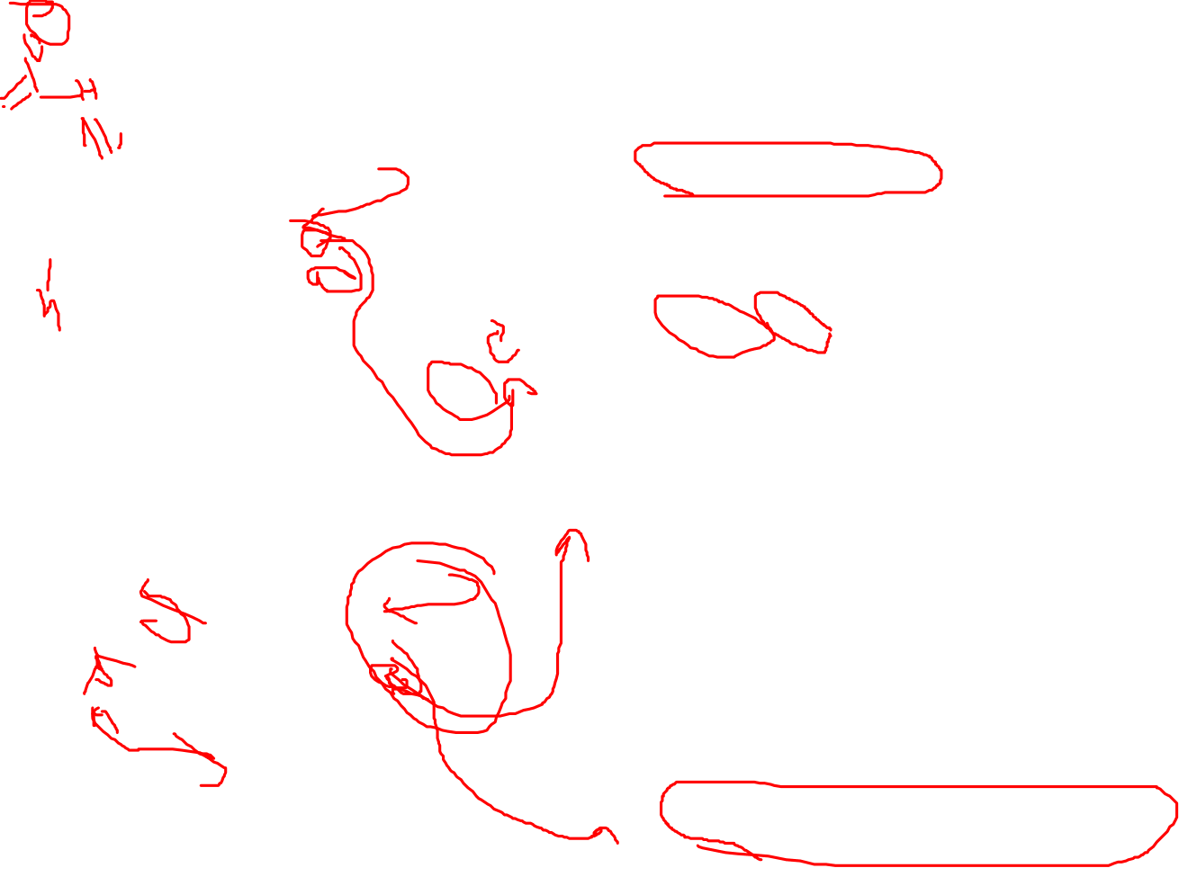
Crossed Aldol Reaction

Slide 8
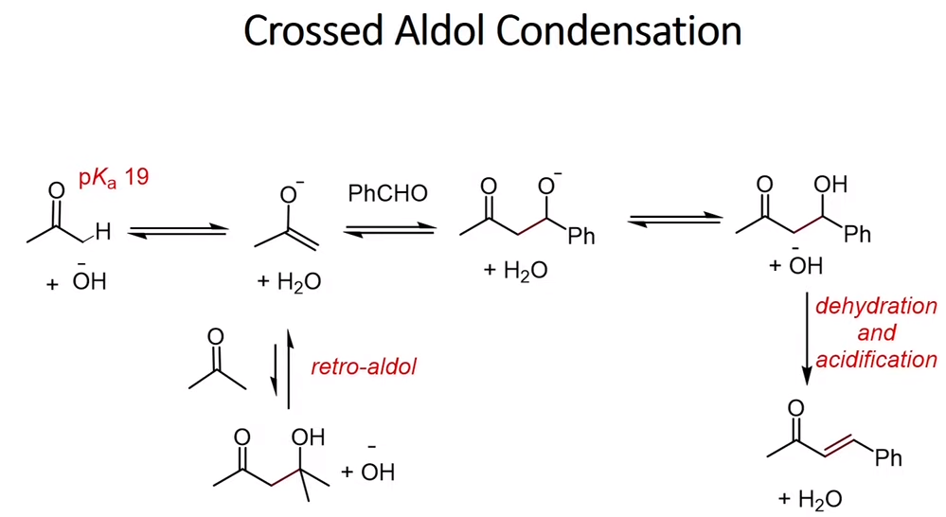
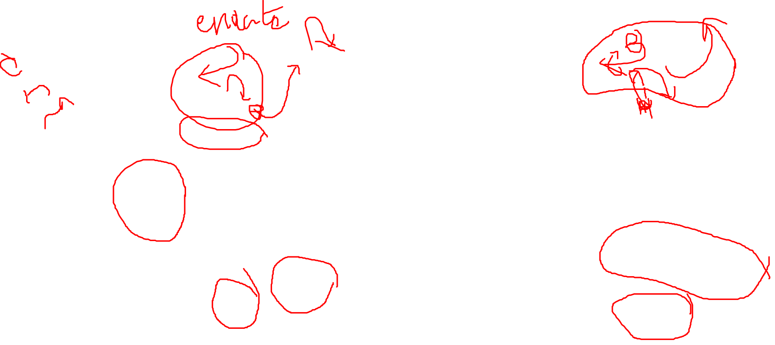
Crossed Aldol Condensation

Slide 9
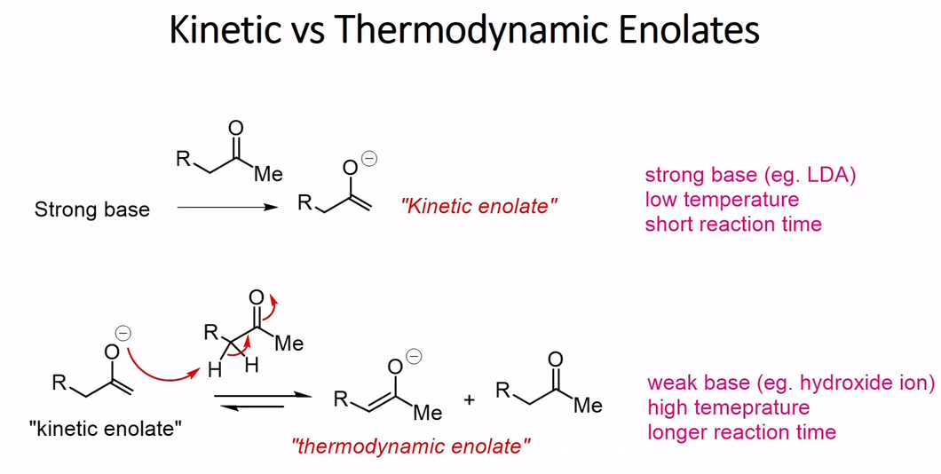
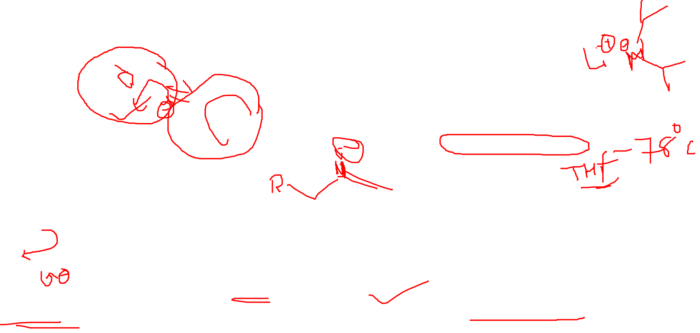
Kinetic Vs Thermodynamic Enolates

Slide 10
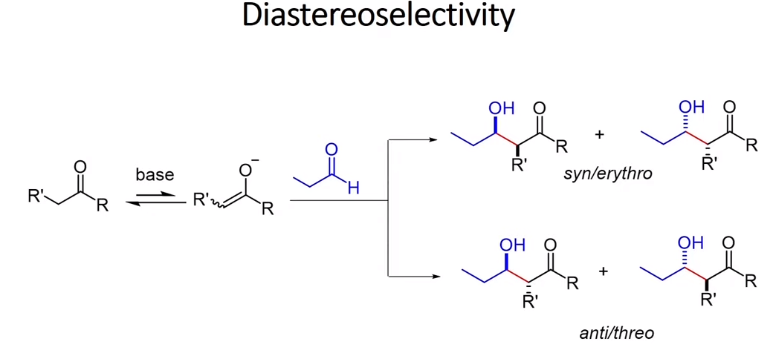
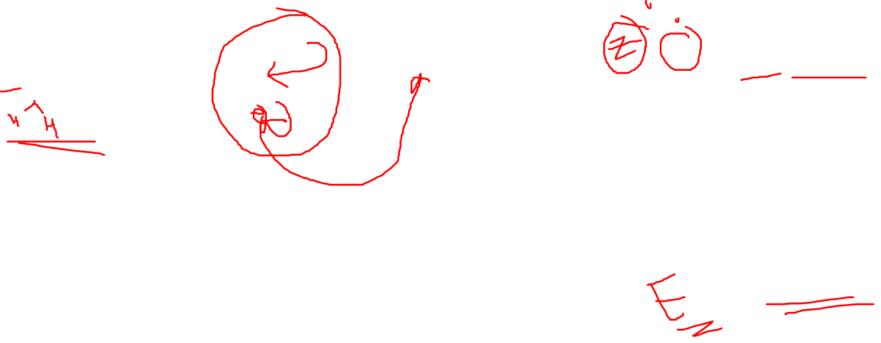
Diastereoselectivity

Slide 11
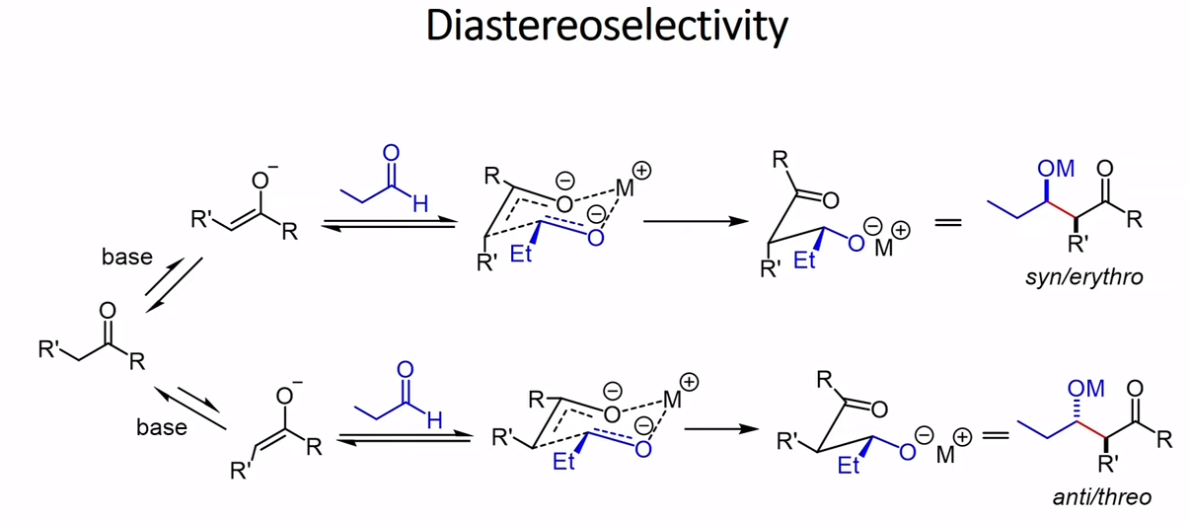
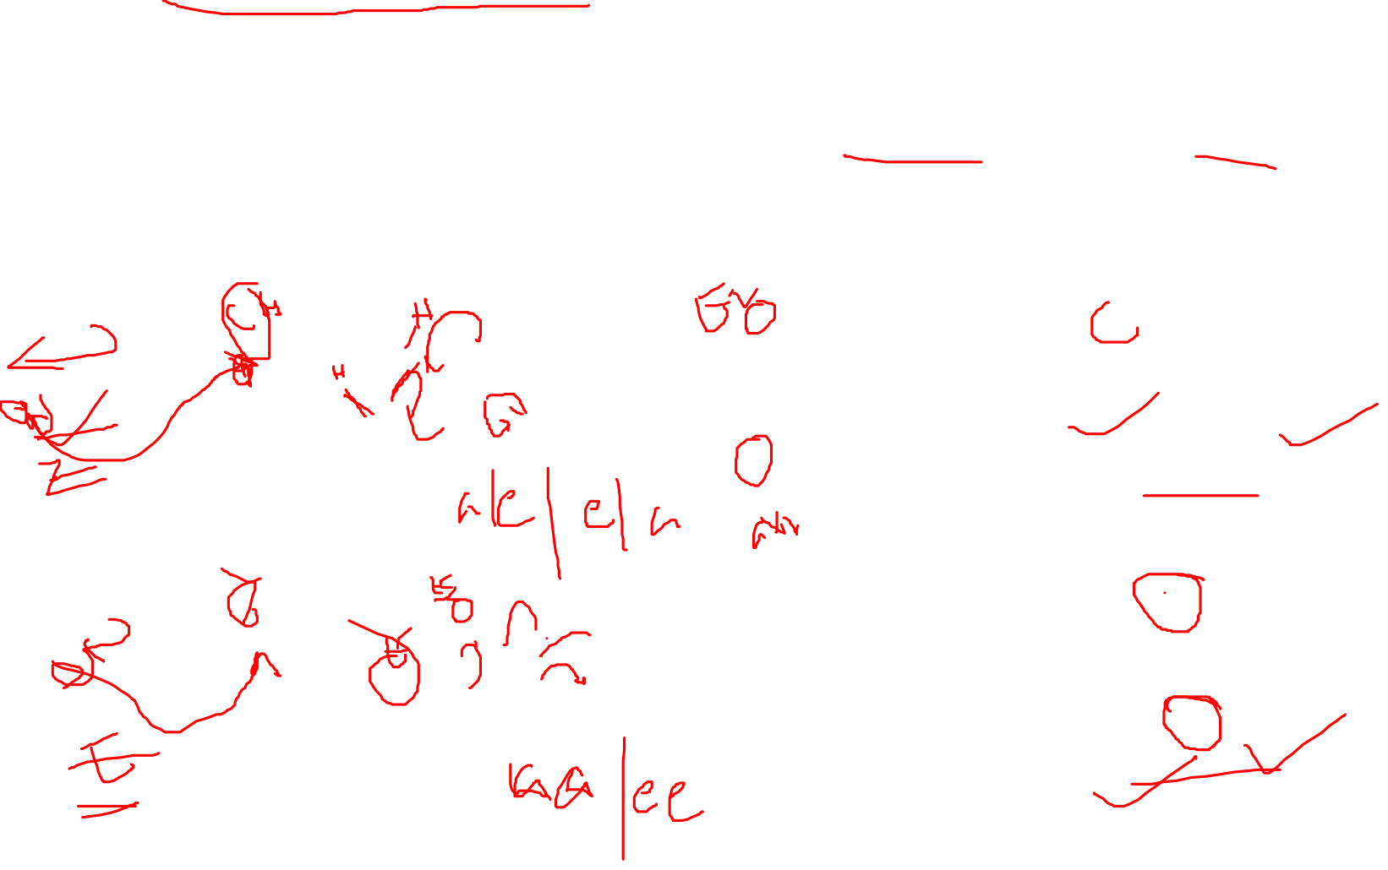
The mechanism of the classical acid catalyzed aldol reaction involves the equilibrium formation of an enol, which functions as a nucleophile. The carbonyl group of the electrophile is activated toward nucleophilic attack by protonation. In the base catalyzed reaction, the enolate is formed by deprotonation followed by the addition of the enolate to the carbonyl group. In both cases, the reaction goes through a number of equilibria, and the formation of the product is reversible. Aldol reaction of preformed enolates generally provides the products with high diastereoselectivity, (Z)-enolates yielding the syn product, (E)-enolates forming the anti product as the major diastereomer. The stereochemical outcome of the reaction can be rationalized based on the Zimmerman-Traxler model, according to which the reaction proceeds through a six-membered chairlike transition state. The controlling factor according to this model is the avoidance of destabilizing 1,3-diaxial interactions in the cyclic transition state.

Slide 12
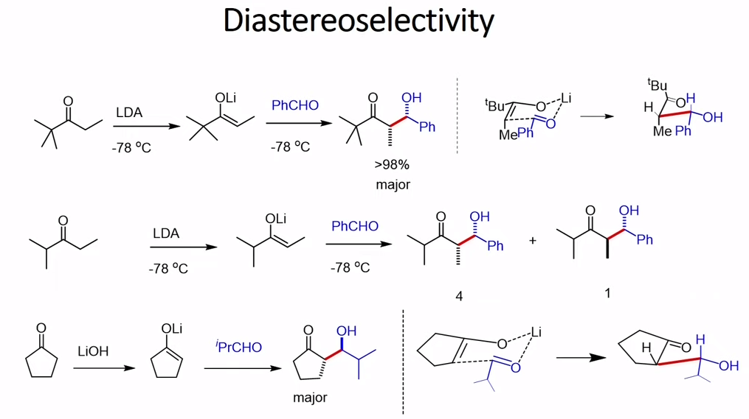
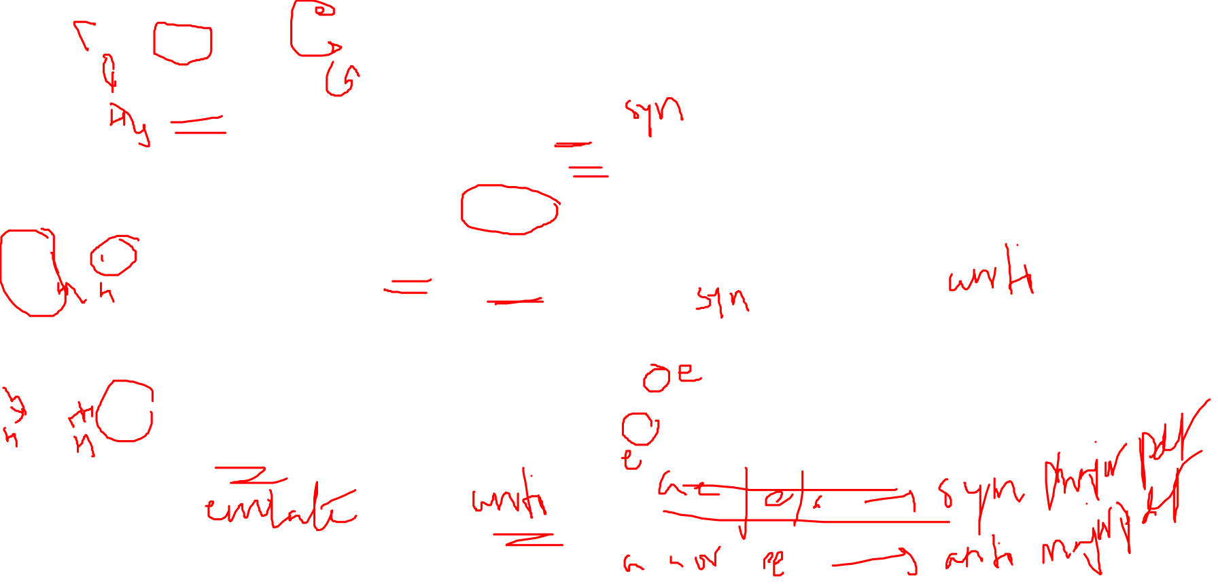
Diastereoselectivity

Slide 13
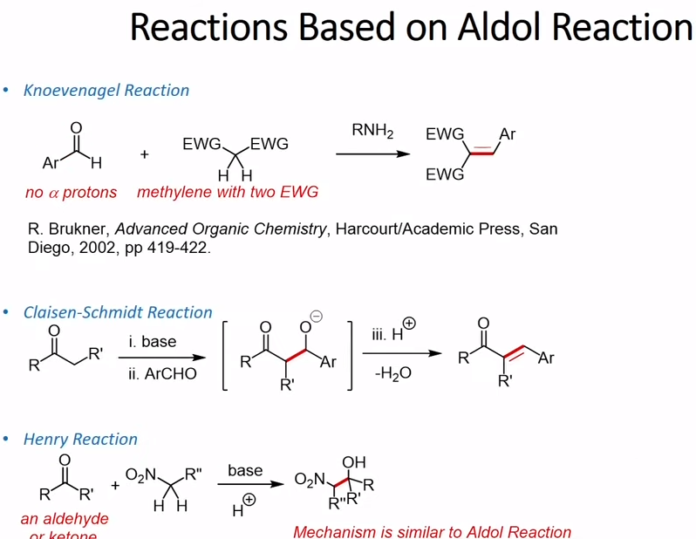
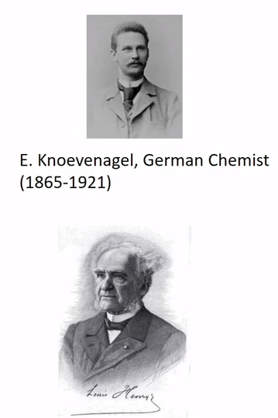
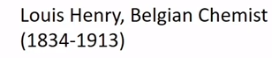
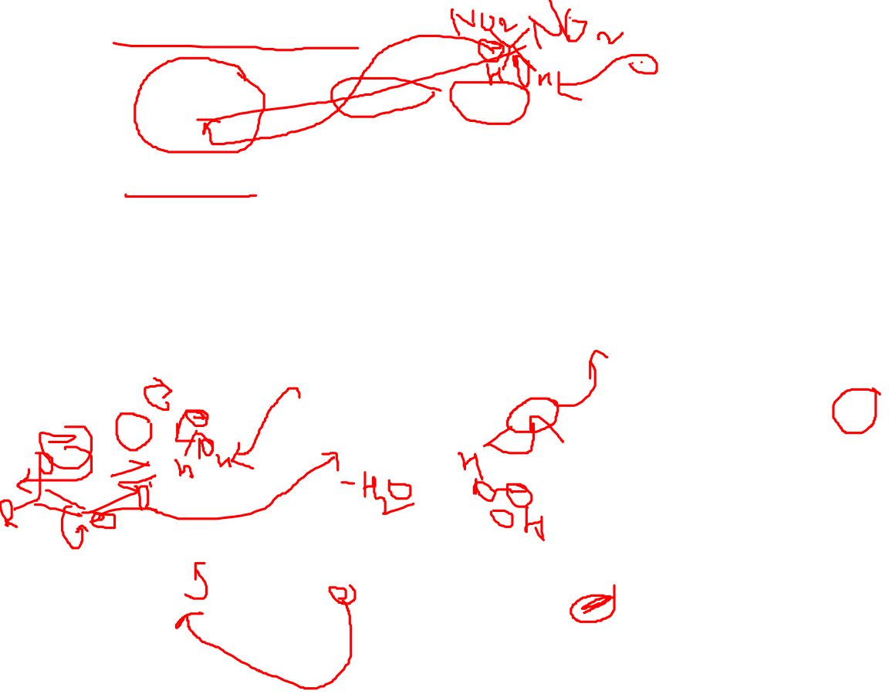
Reactions Based on Aldol reaction

Slide 14
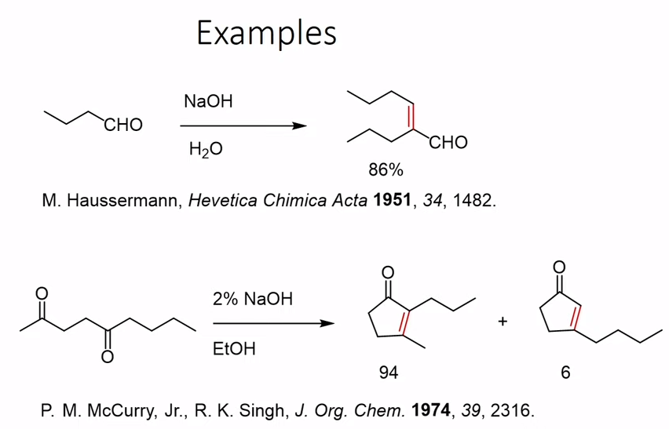
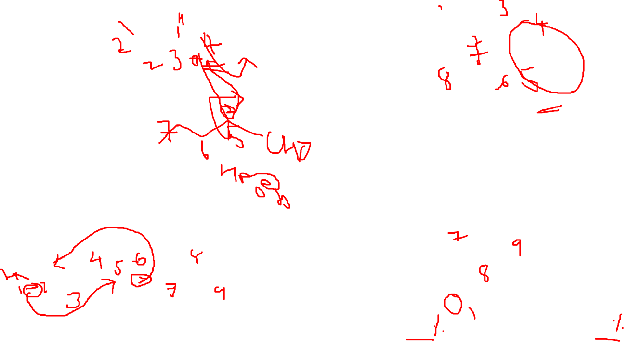
Examples

Slide 15
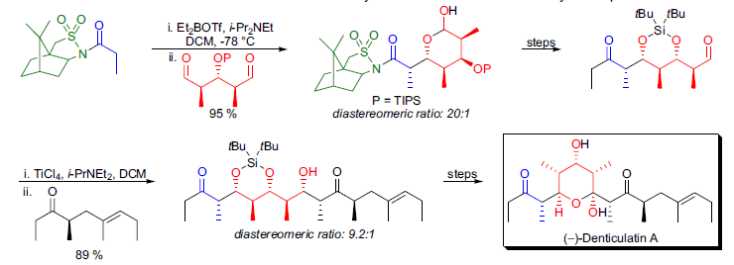
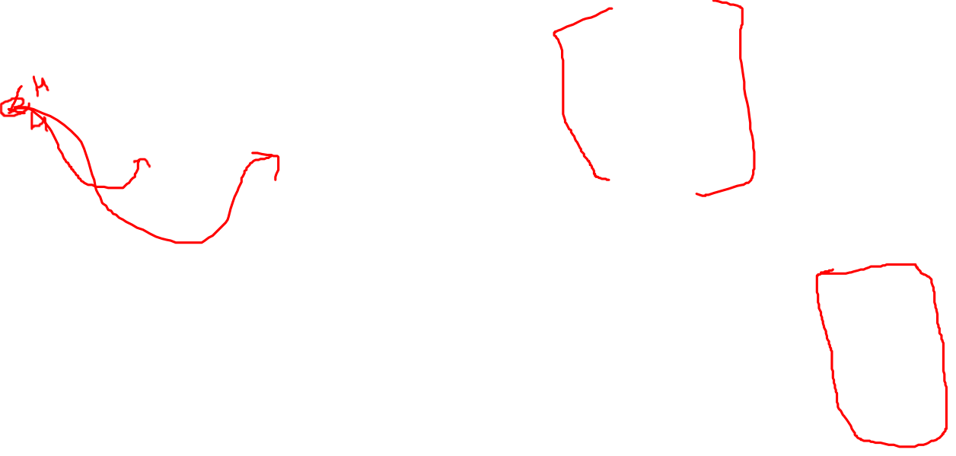
The first enantioselective total synthesis of (–)-denticulatin A was accomplished by W. Oppolzer. The key step in their approach was based on enantiotopic group differentiation in a meso dialdehyde by an aldol reaction. In the aldol reaction they utilized a bornanesultam chiral auxiliary. The enolization of N-propionylbornane-10,2-sultam provided the (Z)-borylenolate derivative, which underwent an aldol reaction with the meso dialdehyde to afford the product with high yield and enantiopurity. In the final stages of the synthesis they utilized a second, doublediastereodifferentiating aldol reaction. Aldol reaction of the (Z)-titanium enolate gave the anti-Felkin syn product. The stereochemical outcome of the reaction was determined by the α-chiral center in the aldehyde component.

Slide 16
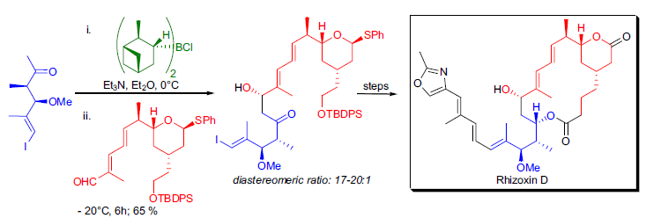

During the total synthesis of rhizoxin D by J.D. White et al., an asymmetric aldol reaction was utilized to achieve the coupling of two key fragments. The aldol reaction of the aldehyde and the chiral enolate derived from (+)-
chlorodiisopinocampheylborane afforded the product with a diastereomeric ratio of 17-20:1 at the C13 stereocenter. During their studies, White and co-workers also showed that the stereochemical induction of the chiral boron substituent and the stereocenters present in the enolate reinforce each other thus representing a “matched” aldol reaction.

Slide 17
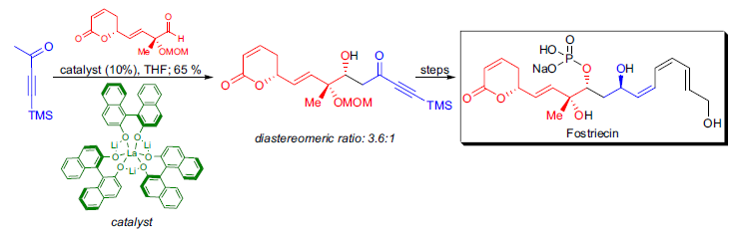
A possible way to induce enantioselectivity in the aldol reaction is to employ a chiral catalyst. M. Shibasaki and coworkers
developed a bifunctional catalyst, (S)-LLB (L=lanthanum; LB=lithium binaphthoxide), which could be successfully applied in direct catalytic asymmetric aldol reactions. An improved version of this catalyst derived from (S)-LLB by the addition of water and KOH was utilized in the formal total synthesis of fostriecin.

